Slide 1
WELCOME TO MY PRESENTATION

Slide 2
MAHBUBA TAMANNA
BATCH : 23

Slide 3
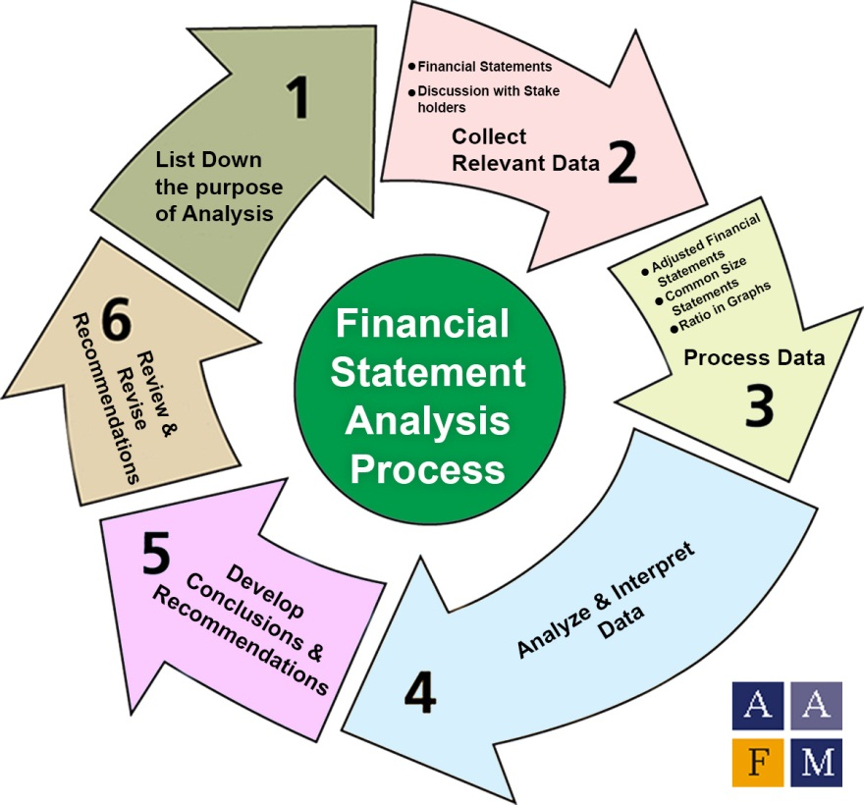
A Project On Financial Statement Analysis

Slide 4
What is financial statement analysis?
Financial statement analysis involves a comprehensive examination of a company's financial statements, including the income statement, balance sheet, and cash flow statement. Analysts assess revenue, earnings, assets, liabilities, and cash flow to gauge financial health and performance

Slide 5
Name of analysis
Revenue
Total Liabilities
Equity
Total Asset
Net Income
Operating Income
Operating Expenses
Gross Profit
C0GS

Slide 6
Potential Questions:
Q- 1 | What is the total revenue generated by Apex Innovations?
Q- 2 | How much is the cost of goods sold (COGS) for Stellar Solutions?
Q- 3 | Find 10 top value companies, who has highest gross profit?
Q- 4 | What is the operating income of Quantum Dynamics?
Q- 5 | Sort the companies from highest to lowest Net Income?
Q- 6 | What is the total assets value of Appex? (Identify each of the segment)

Slide 7
Find top 10 value companies who has highest gross profit?

